Slide 1

Databricks SPARK Hive Demo
https://advancedsqlpuzzles.com
Scott Peters

Slide 2
OBJECTIVE
Connect Databricks to an Azure Key Vault
Connect Databricks to an Azure Data Lake
Create an ETL process to import csv files from an Azure Data Lake
Merge the data into Hive tables
Insert the data into a SQL Server database
Automate the ETL via an Azure Data Factory pipeline
For this demo, we will perform the following...

Slide 3
OBJECTIVE
The Git repository for this demo is located here:
https://Github.com/smpetersGithub/AdvancedSQLPuzzles/tree/main/Suppliers%20and%20Parts%20Hive%20Demo
Included in the repository are the following:
A PDF version of this presentation (Databricks Spark Hive Demo.pdf)
Databricks Workspace (SuppliersAndParts.dbc)
CSV files to import
SQL Server database DDL script

Slide 4
OBJECTIVE
For this demo we will be using the “Suppliers and Parts” database which consists of three csv files.
Suppliers.csv
Parts.csv
Shipments.csv
It’s a popular database that has its own Wikipedia page.
The Suppliers and Parts Wikipedia article is located here:
https://en.wikipedia.org/wiki/Suppliers_and_Parts_database

Slide 5
Azure Resources
First, we will need to provision the following resources:
Azure Key Vault
Azure Data Lake
Azure Data Factory
SQL Server
SQL Server Database
Databricks Workspace

Slide 6
Azure Resources
Few reminders when provisioning your resources.
When provisioning Databricks, select the premium version as this allows for creating secret scopes.
If using an Azure free trial version, you will need to upgrade to a subscription plan to access Databricks.
The Azure Storage Account needs to be provisioned as a data lake.
A basic SQL Server database is will be sufficient for this tutorial. You will need to enable the database server to connect to other Azure resources.

Slide 7
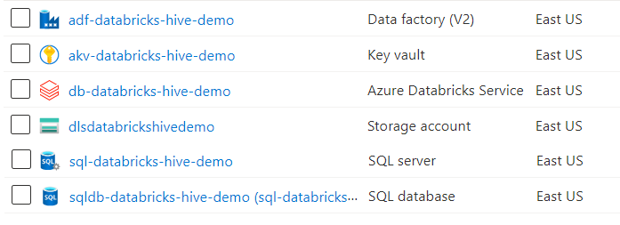
Azure Resources
For this demo I created a resource group “rg-databricks-hive-demo” and provisioned the following resources:
The documentation for Azure naming conventions is located here:
https://docs.microsoft.com/en-us/azure/cloud-adoption-framework/ready/azure-best-practices/resource-abbreviations

Slide 8
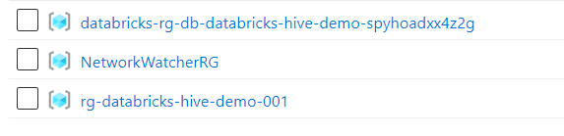
Azure Resources
When you provision the resources, additional resource groups and resources are created.
When you have finished provisioning the resources, you will see an additional resource group for Databricks, and another for the Network Watcher, as shown below.

Slide 9
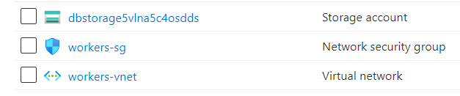
Azure Resources
The “databricks-rg-db-databricks-hive-demo-spyhoadxx4z2g” resource group has the following resources:
The “NetworkWatcherRG” resource group has the following resources:

Slide 10
Azure Resources
Here are the Azure resource names if you want to copy and paste.
db-databricks-hive-demo (Databricks)
dlsdatabrickshivedemo (Azure Data Lake)
akv-databricks-hive-demo (Azure Key Vault)
sqldb-databricks-hive-demo (SQL Database)
sql-databricks-hive-demo (SQL Server)
adf-databricks-hive-demo (Azure Data Factory)

Slide 11
Databricks
Next, we will connect our resources together.
In Databricks, we will need to understand two concepts:
Secret Scopes
Databricks Tokens
First, we will begin with secret scopes.
Secret scopes allow you to securely connect to your Azure Key Vault service, where we will store our database and storage account credentials.
There are two different ways of creating a scope:
Azure Key Vault backed
Databricks backed
The Databricks secret scope documentation is located here:
https://docs.microsoft.com/en-us/azure/databricks/security/secrets/secret-scopes

Slide 12
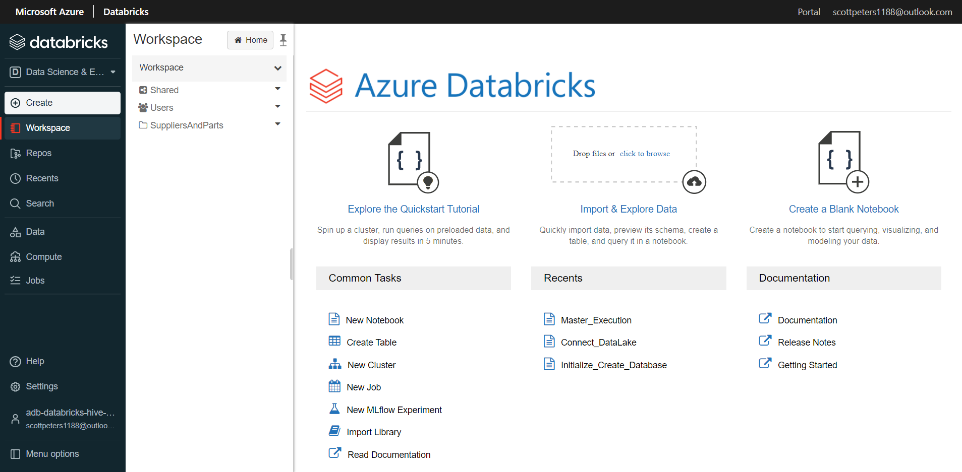
Databricks
Open the Databricks Workspace.

Slide 13
Databricks
Next, in the Databricks workspace, access the secret scope window.
To access the secret scope window in Databricks, attach the string “#secrets/createScope” after your Databrick’s instance.
A Databrick’s instance will have the following URL:
https://<databricks-instance>#secrets/createScope
This URL is case sensitive; scope in createScope must be uppercase.
The documentation for Databricks secret scopes is located here:
https://docs.microsoft.com/en-us/azure/databricks/security/secrets/secret-scopes

Slide 14
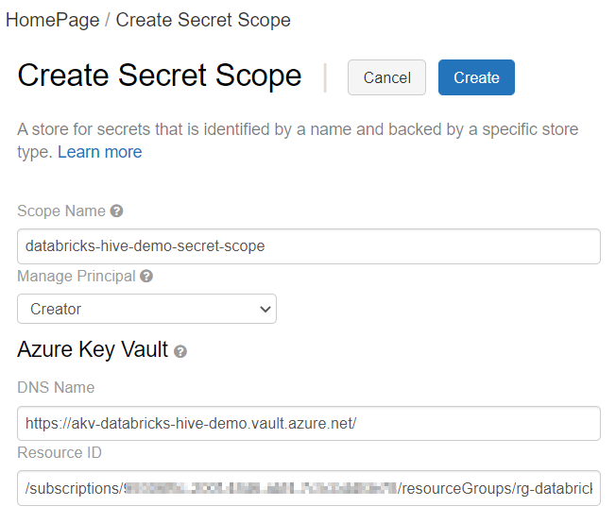
Databricks Secret scope
The “Create Secret Scope” window will look like the following.
We will cover the “DNS Name” and “Resource ID” in next slides.

Slide 15
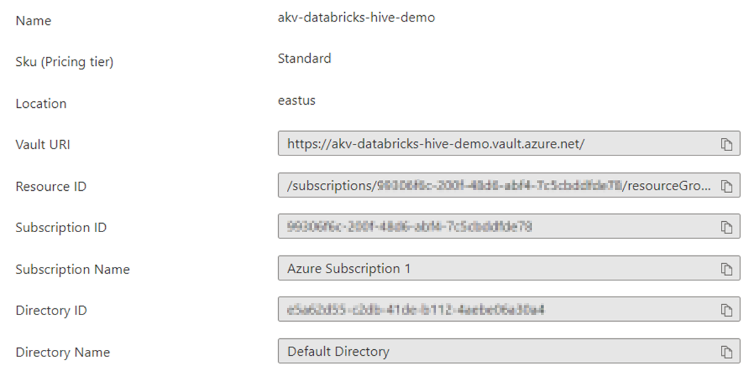
Databricks Secret scope
Azure Key Vault Properties Page
The DNS Name (Vault URI) and the Resource ID are in your Azure Key Vault properties page.
Copy these values from your Azure Key Vault properties page and insert the values into your “Create Secret Scope” window.

Slide 16
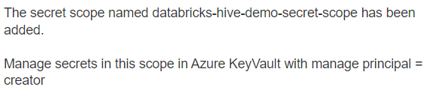
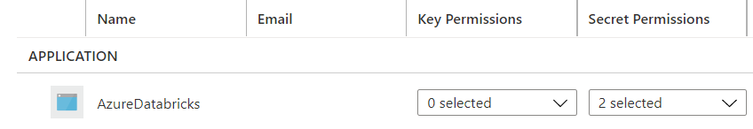
Databricks Secret scope
Once completed, you will get the following confirmation.
And you will see the following access policy added to the key vault.
The documentation for the Azure Key Vault access policies is located here:
https://docs.microsoft.com/en-us/azure/key-vault/general/assign-access-policy?tabs=azure-portal

Slide 17
Databricks Token
Next, we will create a Databricks token.
This token will allow the Azure Data Factory to access the Databricks notebook. Tokens replace passwords in an authentication flow and should be protected like passwords.
We will use this token when we setup a linked service in our Azure Data Factory.
The documentation for Databricks tokens is located here:
https://docs.databricks.com/dev-tools/api/latest/authentication.html
This token will be stored in the Azure Key Vault, which we will setup later.

Slide 18
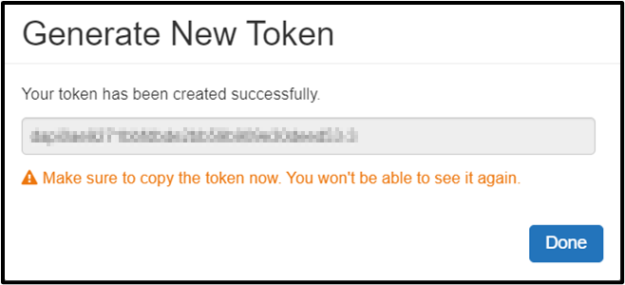
Databricks Token
Create a token in Azure Databricks by navigating to the “User Settings” in your Databricks workspace and selecting “Generate New Token”.
Save the token, as directed by the yellow warning message.
I created the token “databricks-hive-demo”, but it is the token’s value that is important, not the name. This token will be stored in the Azure Key Vault, which we will setup later.
Once created, you will see the following in your Databricks “User Settings”.

Slide 19
Azure Data Lake
Next, we will setup the Azure Data Lake.
Navigate to the storage account you provisioned and create two containers:
source
hive
Within the “hive” container create a directory called “database”.
Within the “source” container, create a directory called “SuppliersAndParts”.
The directory “source > SuppliersAndParts” is where we will store the csv files to import, and “hive > Database” will contain the Hive tables (which we will create later).
Upload the text files from the Git repository into the “source > SuppliersAndParts” container.

Slide 20
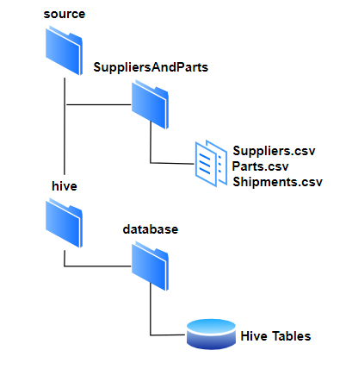
Azure Data Lake
Your file structure in the storage account will look like the following:
Copy the files “Suppliers.csv”, “Parts.csv”, and “Shipments.csv” files into the “SuppliersAndParts” folder.
The “database” folder will contain the Hive tables, which we will setup later in this demo.
The Git repository for this demo is located here:
https://Github.com/smpetersGithub/AdvancedSQLPuzzles/tree/main/Suppliers%20and%20Parts%20Hive%20Demo

Slide 21
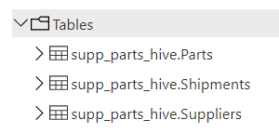
SQL SERVER DATABASE
Next, we will create the schema and tables in the SQL Server database.
The script to create the schema and tables is provided in the Git directory.
We will create a schema named “supp_parts_hive” and the following tables:
The Git repository for this demo is located here:
https://Github.com/smpetersGithub/AdvancedSQLPuzzles/tree/main/Suppliers%20and%20Parts%20Hive%20Demo

Slide 22
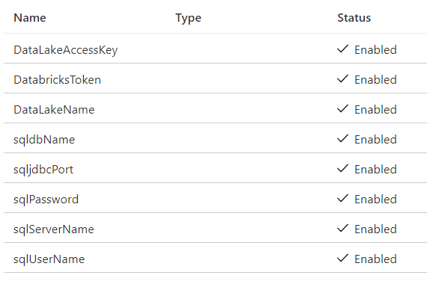
AZURE KEY VAULT
Next, we will create the secrets inside of the Azure Key Vault.
Here are the secrets you will need to setup in the Azure Key Vault.
Databricks will be able to access these values via the secret scope we created earlier.
These secrets will be used within the Databricks notebooks, except for “DatabricksToken”, which will be used by the Azure Data Factory linked service.

Slide 23
AZURE KEY VAULT
Secret Name | Value | Description
sqljdbcPort | 1433 | This should always be 1433
sqldbName | sqldb-databricks-hive-demo | The name of the database
sqlPassword | MyPassword | The password of the database
sqlUserName | MyUserName | The admin user of the database
sqlServerName | sql-databricks-hive-demo.database.windows.net | The database server connection string
DataLakeAccessKey | Review the next few slides…. | Copied from the storage account properties
DataLakeName | dlsdatabrickshivedemo | The name of the storage account
DatabricksToken | Created in previous slides… | Used by Data Factory linked service
The two services we need Databricks to authenticate to are:
SQL Server Database
Azure Storage Account
The secret “DatabricksToken” will be used by the Data Factory linked service.
We will create the Azure Storage Account access key in the next slides.

Slide 24
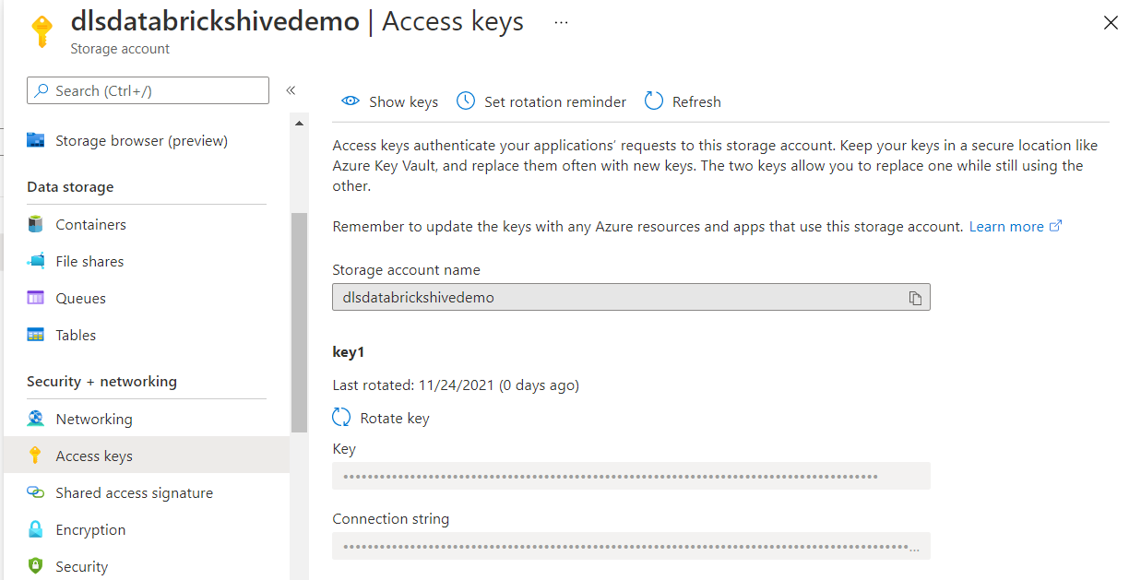
AZURE KEY VAULT
The secret “DataLakeAccessKey” is created by navigating to your storage account and copying the access key.
The documentation for Azure Storage Account access keys is located here:
https://docs.microsoft.com/en-us/azure/storage/common/storage-account-keys-manage?tabs=azure-portal

Slide 25
Recap
Let’s do a quick recap of everything we have accomplished so far:
We have provisioned our Azure Resources
We created a Databricks secret scope
We created a Databricks token
We setup our Azure Storage Account as a data lake with the needed directories and imported the csv files
We created the schema and tables in our SQL Server Database
We created the secret keys in our Azure Key Vault

Slide 26
Recap
Next, we will perform the following:
Import a Databricks workspace
Create a Databricks cluster
Run the database setup scripts
Review the code in the workspace
Test our Databricks workspace
Create an Azure Data Factory pipeline
Execute the Azure Data Factory pipeline

Slide 27
DATABRICKS
The following documentation gives a good overview of what we will be accomplishing for the remainder of these slides. Take a few moments to review the following documentation.
If you are unfamiliar with creating clusters, running notebooks, or navigating the workspace, I recommend working through a basic tutorial of Databricks before proceeding.
A Microsoft tutorial for incorporating Databricks into Data Factory is located here:
https://docs.microsoft.com/en-us/azure/data-factory/transform-data-using-databricks-notebook

Slide 28
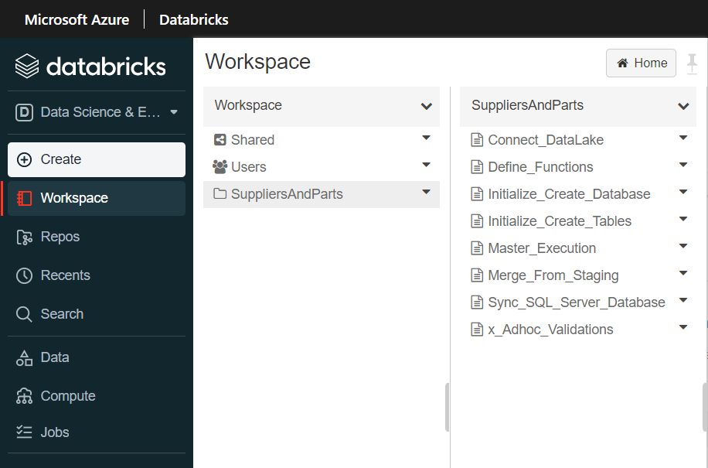
DATABRICKS
First, we will begin by importing the “SuppliersAndParts.dbc” workspace from the Git repository.
This workspace contains the notebooks needed to create our ETL.
Once you import the dbc file, you will see the following “SuppliersAndParts” folder in your workspace.
Begin by importing the workspace from the Git repository.

Slide 29
DATABRICKS
Included Notebooks
Connect_DataLake
Create_Database
Create_Tables
Insert_Hive_Staging_Functions
Insert_SQL_Server_Database
Master_Execution
Merge_Hive_Production
Validation
The workbook consists of the following notebooks:

Slide 30
DATABRICKS
Notebook | Description
Create_Database | Initial script to create the Hive database.
Create_Tables | Initial script to create the Hive tables.
Connect_DataLake | Reads variables from the Azure Key Vault and connects to the Azure Data Lake. This notebook is used by all other notebooks.
Insert_Hive_Staging_Functions | Recreates the Hive staging tables and then inserts the data from the csv file into the staging table. This is the first notebook to execute in the pipeline.
Merge_Hive_Production | Creates the functions needed to import the csv files into the staging tables. This is the first notebook to run in the pipeline.
Insert_SQL_Server_Database | Truncates and then inserts the data from the Hive production tables into the SQL Server database tables. This is the third notebook to execute in the pipeline.
Master_Execution | The master notebook which calls all other notebooks.
Validation | General script used for auditing
Here is a brief description of each notebook sorted by their purpose.
We will cover each of these notebooks in more detail.

Slide 31
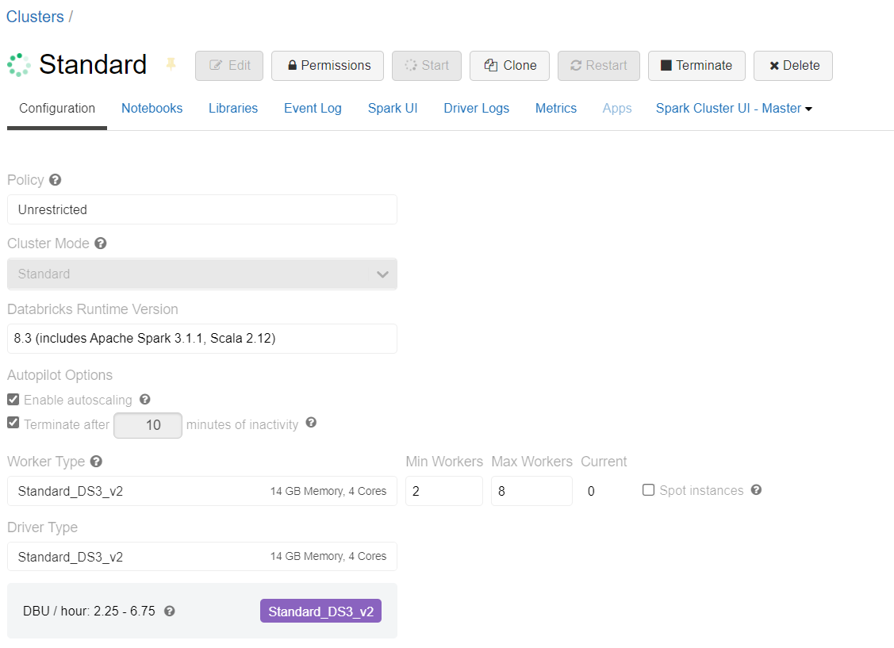
DATABRICKS
Before we move on, we need to create a Databricks cluster to run our notebooks.
The documentation for configuring Databricks clusters is located here:
https://docs.microsoft.com/en-us/azure/databricks/clusters/configure
Remember to put a termination activity time on the cluster!
Here are the details of the cluster I have created for this demo.
A simple standard cluster will suffice. Feel free to experiment with different cluster sizes.

Slide 32
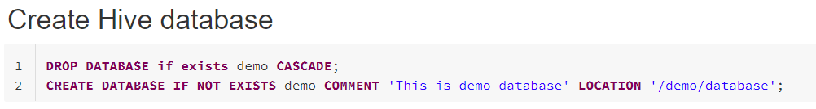
DATABRICKS
Run the following notebook first:
Create_Database
The following SQL statement creates a Hive database named “demo”.
Let’s first run the notebooks that create the Hive database and tables.

Slide 33
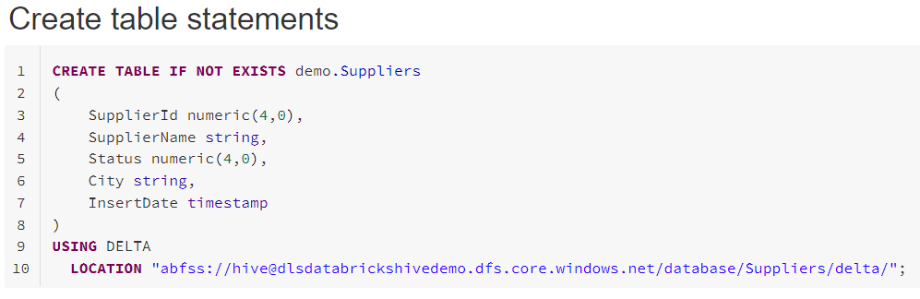
DATABRICKS
Run the following notebook next:
Create_Tables
This will create the three production tables for 1) Suppliers, 2) Parts and 3) Shipments.
You will need to change the location only if you named the Azure Storage Account directory differently than this demo.
Second, create the tables for the Suppliers, Parts and Shipments data.

Slide 34
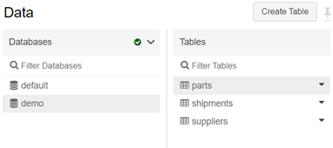
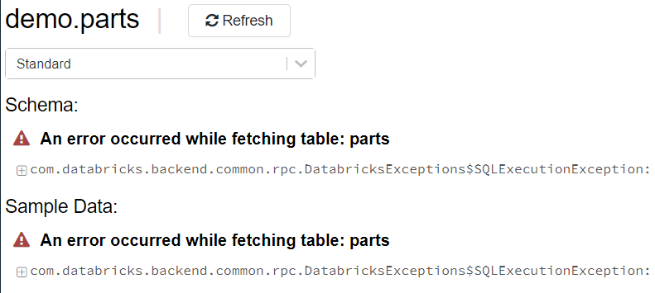
DATABRICKS
After creating the tables, you will see the production tables in the “Data” pane of the workspace. The staging tables will appear here after we run the pipeline for the first time.
Second, create the tables for the Suppliers, Parts and Shipments data.
You will get the following error when you select a table.
This is perfectly normal.

Slide 35
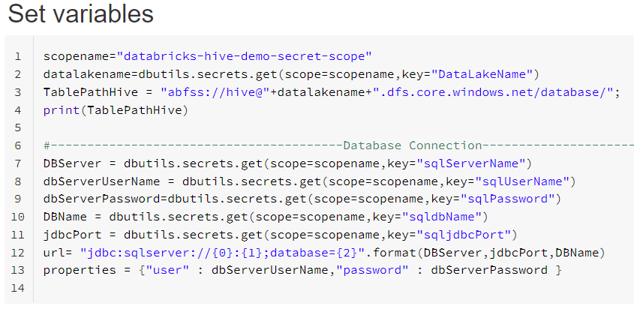
DATABRICKS
Run the following notebook to test the connection to the Azure Key Vault and the Azure Storage Account services.
Connect_DataLake
The following code connects to the Azure Key Vault.
If the Azure Key Vault secret names are different than this demo, you will need to modify these values. Note the only variable hardcoded is the secret scope that we created earlier.
Next, we will test the connection to the Azure Key Vault and the Azure Storage Account.

Slide 36
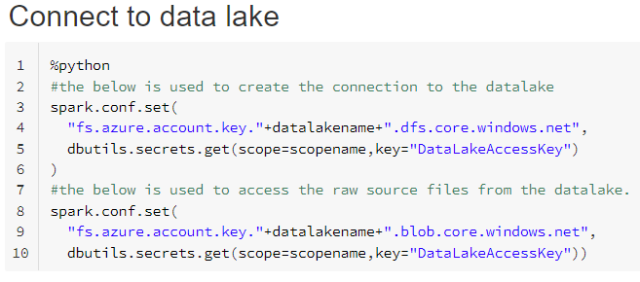
DATABRICKS
Connect_DataLake
The following code creates the connection to the data lake.
It connects once with the “dfs” syntax, and then again with the “blob” syntax.
Next, we will test the connection to the Azure Key Vault and the Azure Storage Account.
The documentation for Spark configuration settings is located here:
https://docs.microsoft.com/en-us/azure/databricks/kb/data/get-and-set-spark-config

Slide 37
DATABRICKS
Master_Execution
The “Master_Execution” notebook will run once for each of the three csv files:
Suppliers.csv
Parts.csv
Shipments.csv
This notebook calls the following notebooks in order:
Insert_Hive_Staging_Functions
Merge_Hive_Production
Insert_SQL_Server_Database
Next, let’s test if we can run the master notebook.

Slide 38
DATABRICKS
Master_Execution
This notebook performs the following steps:
Step 1
It first reads the functions from the “Insert_Hive_Staging_Functions”, which also reads the “Connect_DataLake” notebook.
Step 2
It then determines the variables “FileName” and the “ProcessName”.
Step 3
Next, it runs the function “ProcessHiveStagingData”, which is located in the the “Insert_Hive_Staging_Functions” notebook.
Step 4
It then runs the “Merge_Hive_Production” notebook, and then the “Insert_SQL_Server_Database”.
Next, let’s test if we can run the master notebook.

Slide 39
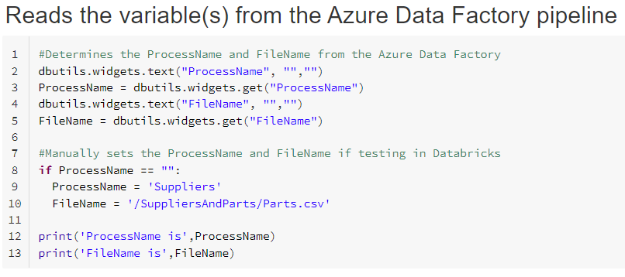
DATABRICKS
DBUTILS.WIDGETS
The “dbutils.widgets” code reads the variable “ProcessName” and “FileName” from the Azure Data Factory.
To test the code in Databricks, manually set the value of “ProcessName” and “FileName” where applicable.
Next, let’s test if we can run the master notebook.

Slide 40
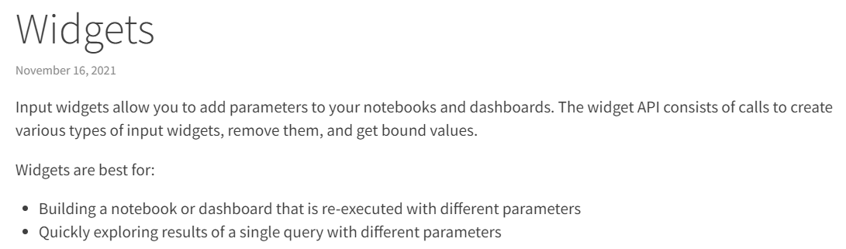
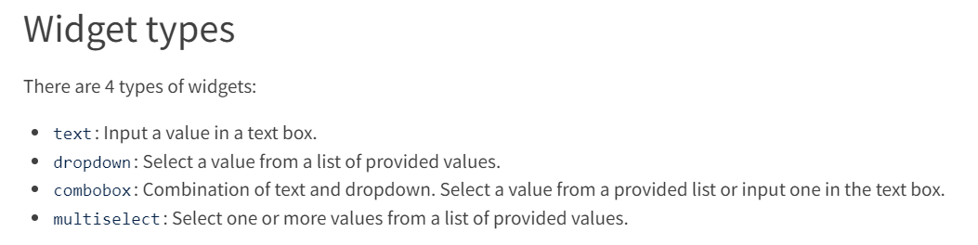
DATABRICKS
DBUTILS.WIDGETS
The documentation for Databricks widgets is located here:
https://docs.databricks.com/notebooks/widgets.html
Next, let’s test if we can run the master notebook.

Slide 41
DATABRICKS
Insert_Hive_Staging_Functions
This notebook defines the following functions needed to import and verify the csv file and insert it into the staging table.
GetSchema (Define the schema details for the file)
GenerateIncomingDataHeader (Create a data frame of the file header)
VerifyHeader (Validate incoming file header to schema definition)
ProcessHiveStagingData (Reads the csv file and executes the InsertDataToHive function)
InsertDataToHive (Inserts the data into the Hive tables)

Slide 42
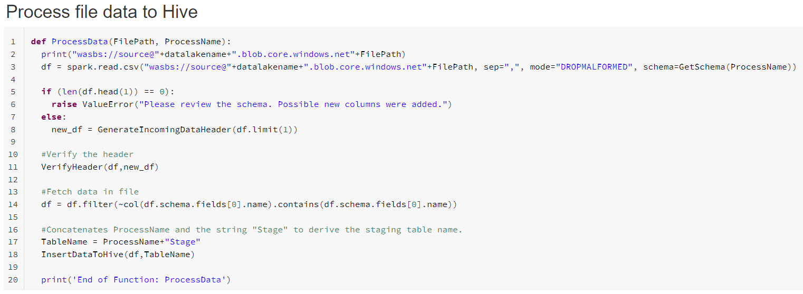
DATABRICKS
Insert_Hive_Staging_Functions
In the “ProcessData” function, the variable “TableName” is the concatenation of the variable “ProcessName” and the string “Stage”.

Slide 43
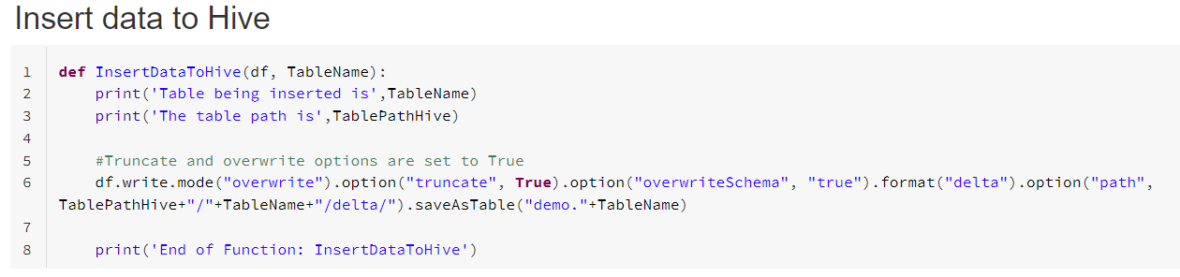
DATABRICKS
Insert_Hive_Staging
The insert into the staging table has the options of “overwrite” and “truncate” and “overwriteSchema”.
On each execution the staging table is recreated and then inserted into.

Slide 44
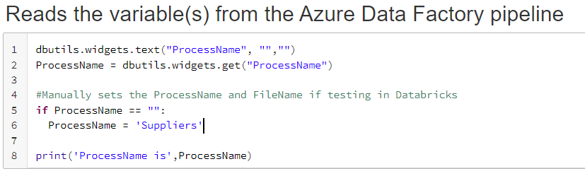
DATABRICKS
Merge_Hive_Production
This notebook merges the data from the staging to the production tables.
This notebook also uses the “dbutils.widgets”, which we have discussed in previous slides.
To run this notebook in Databricks for the “Suppliers.csv” file, manually set the variable “ProcessName” to “Suppliers”.
Now we will review some of the specifics in the code.

Slide 45
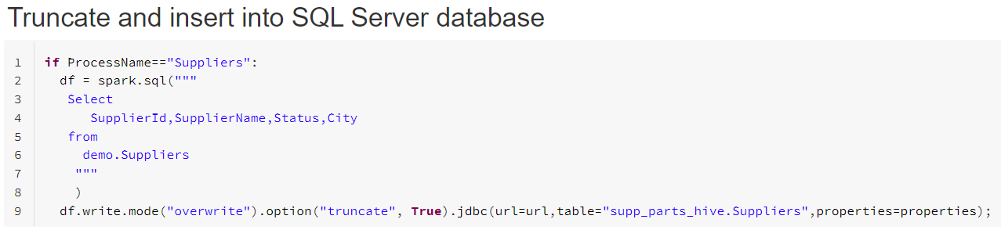
DATABRICKS
Insert_SQL_Server_Database
The insert into to the SQL Server database has the same overwrite and truncate options as the inserts into the Hive staging tables.
If you receive connection errors to the database, check that the SQL Server has the option set to connect to other Azure services.

Slide 46
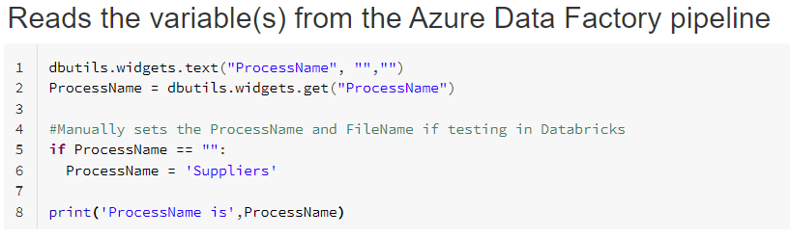
DATABRICKS
Insert_SQL_Server_Database
This notebook also uses the “dbutils.widgets”.

Slide 47
DATABRICKS
Validations
This notebook is for creating and saving any ad-hoc statements.
After you have ran an ETL, I recommend using this notebook to explore the data.
Remember you may have only tested on your Suppliers data. The Parts and Shipments tables may be blank if you have not tested these processes.
Also available in this notebook is how to view the history of the tables.
Now we will review some of the specifics in the code.

Slide 48
DATA FACTORY
Next, we will setup the Azure Data Factory.
We will need to create two Azure Linked Services.
One to link to our 1) Azure Key Vault, and the second to link to the 2) Databricks Workspace.
The Databricks Linked Service will utilize the Azure Key Vault Linked Service and access the Database token we setup earlier in the demo.

Slide 49
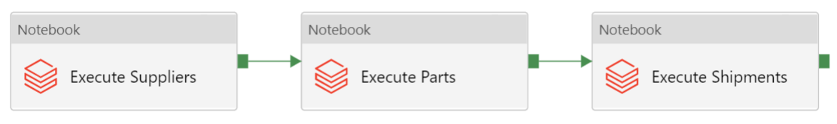
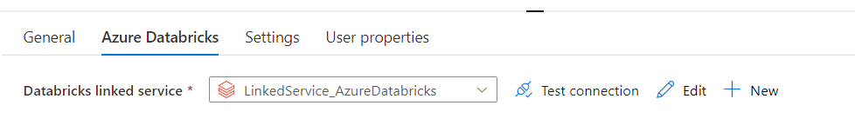
DATA FACTORY
Before we create the linked services, create a pipeline and add three Databricks notebooks activities. Chain them together to avoid getting “unexpected failure while waiting for the cluster” errors.
Each of these activities will utilize the Databricks linked service we will create in the next slides.

Slide 50
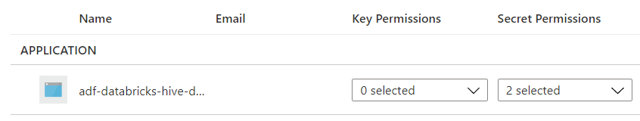
DATA FACTORY
First, the Data Factory will need access to the Azure Key Vault. Navigate to your Azure Key Vault and add an access policy that allows the Data Factory secret permissions.
The Azure Key Vault you provisioned will now have an access policy for your Databricks and the Data Factory.

Slide 51
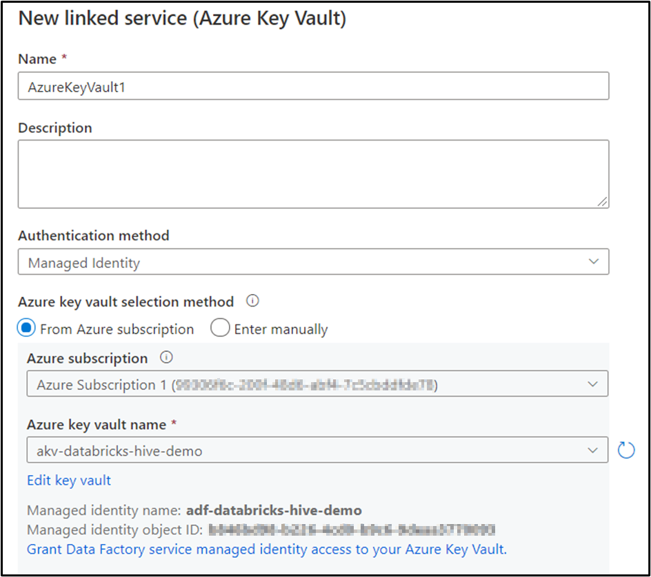
DATA FACTORY
AKV Linked Service
To link to the Azure Key Vault, create the AKV linked service using your Azure subscription.
You can also enter the AKV manually by providing the URL of the linked service, which is located in the properties page of the AKV.

Slide 52
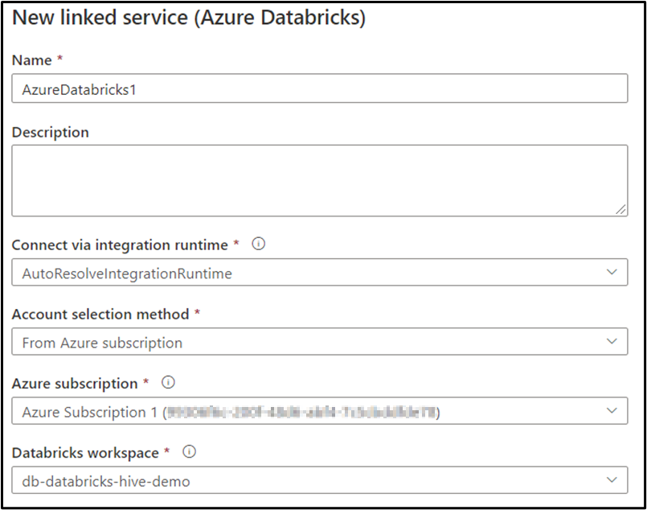
DATA FACTORY
Databricks Linked Service
To link to the Databricks workspace, fill in the following dropdowns with your subscription and workspace information.
You can also enter the information in manually by selecting “Enter Manually” from the dropdown box.

Slide 53
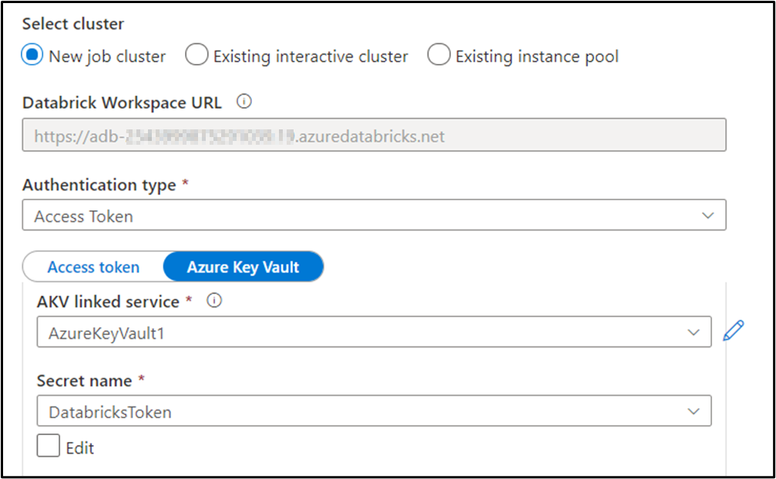
DATA FACTORY
Databricks Linked Service
Next, select “Access Token” as the authentication type.
Link to the AKV by using the linked service we created in a prior slide.
Then select the secret name you used to store the Databricks token.

Slide 54
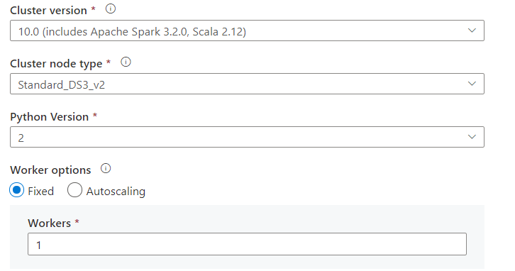
DATA FACTORY
Databricks Linked Service
Finish the linked service by filling in the rest of the fields.
Here you can see the options that I chose for cluster version, node type, etc.….
Selecting a new job cluster is the best option for cost savings, but it does add a few minutes of processing time to the pipeline to allow for the cluster to start up.

Slide 55
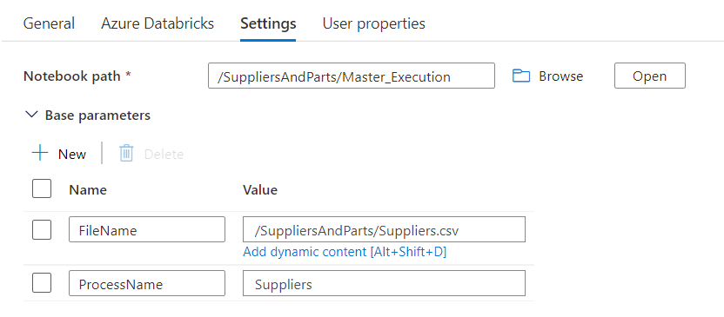
DATA FACTORY
Now let’s move back to the following pipeline activities and update the “Settings” tab for each activity.
Select the notebook path and create two parameters 1) “FileName” and 2) “ProcessName”.
Fill in the appropriate information as shown in the screenshot.
You will need to do this for the 1) Suppliers, 2) Parts and 3) Shipments activities.

Slide 56
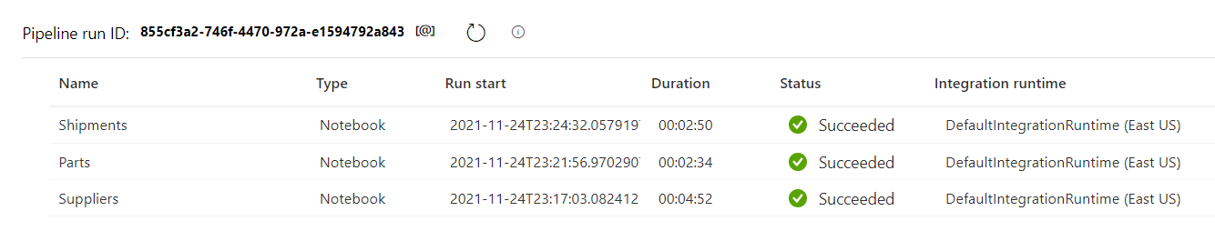
DATAFACTORY
Execute the pipeline by selecting “Debug”.
Ensure there is no running cluster in your Databricks workspace before executing, else you will get “unexpected failure while waiting for the cluster” error.
The total execution time for my pipeline is around 11 minutes.

Slide 57
TESTING
To test your ETL, review the data in your Hive tables with the statements in the “Validations” notebook. Also, review the data in the SQL Server tables as well.
Then alter the CSV files by adding new records and modifing the current records. Run the pipeline and verify the output.
To best learn the specifics of the Databricks notebooks, I recommend changing names of your AKV, storage account, secret names, etc… determine where the notebooks break and fix accordingly.

Slide 58
CONGRATULATIONS
You now have a template for using Databricks as a transformation service!
Check out my Git repository and SQL blog for all sort of puzzles, tips and tricks.
The Git repository for this demo is located here:
https://Github.com/smpetersGithub/AdvancedSQLPuzzles/tree/main/Suppliers%20and%20Parts%20Hive%20Demo

